Slide 1
AIRCTRAFT FATALITY PRESENTATION

Slide 2
BUSINESS PROBLEM
Your company is expanding into new industries to diversify its portfolio. Specifically, they are interested in purchasing and operating airplanes for commercial and private enterprises, but do not know anything about the potential risks of aircraft. You are charged with determining which aircraft are the lowest risk for the company to start this new business endeavor. You must then translate your findings into actionable insights that the head of the new aviation division can use to help decide which aircraft to purchase.

Slide 3
Overview of Business Understanding
This project aims to solve potential risks in the aircraft business. The company aims at reducing risk and uncertainty in the company as the company aims at expanding the business. Since the company has no prior experience in the potential risk of aircraft, the business aims at coming up with the lowest risk aircraft that are safe to them and additionally profitable to the business.

Slide 4
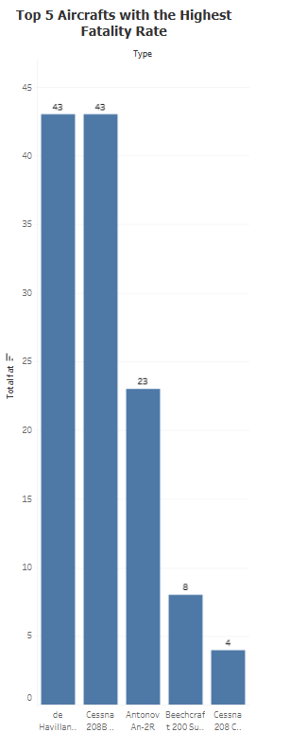

Slide 5
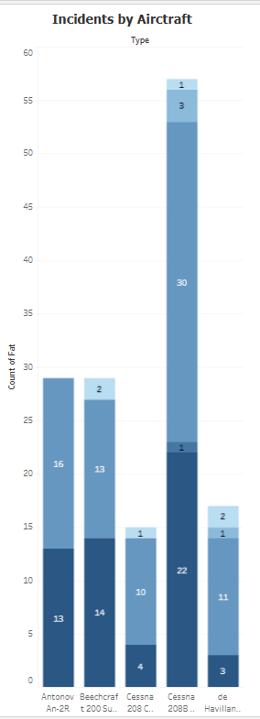

Slide 6
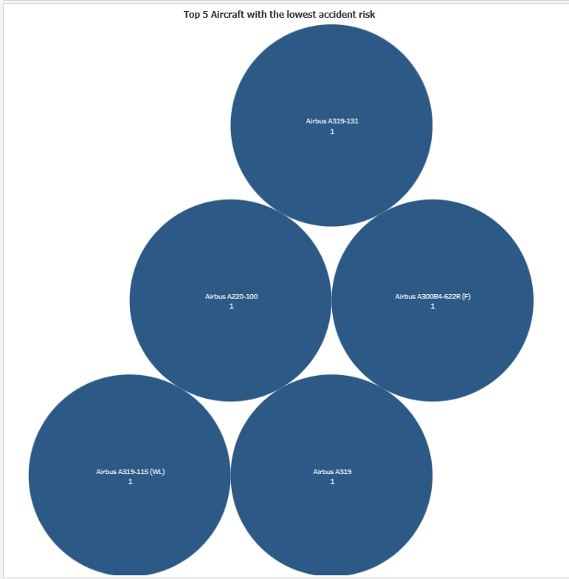

Slide 7
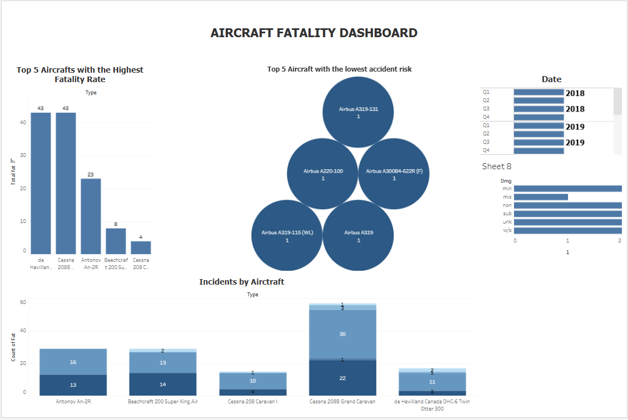

Slide 8
THE END.

